Slide 1
Raising Children and Adolescents Who are Prepared to THRIVE “Balancing Protection with Trust”
Ken Ginsburg, MD, MS Ed
The Children’s Hospital of Philadelphia

Slide 2
How do we define
success?

Slide 3
The ability to overcome adversity
The capacity to bounce back
Resilience

Slide 4
Resilience is a mindset

Slide 5
Resilience is NOT invulnerability

Slide 6
The bottom line
Young people will be more resilient if the important adults in their lives believe in them unconditionally and hold them to high expectations
Young people live up or down to the expectations we set for them

Slide 7
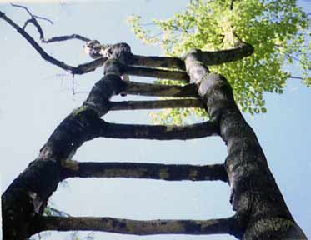
The 7 C’s of Resilience
1. Confidence
2. Competence
3. Connection
4. Character
5. Contribution
6. Coping
7. Control
References: Little, 1993; Pittman et al., 2003; Eccles & Gootman , 2002; Roth & Brooks-Gunn 2003; Lerner, 2004; Ginsburg, 2006; Frankowski, Leader & Duncan, 2009.

Slide 8
Listening

Slide 9
Learning how to fail and recover-
Under our watchful eyes or in the real world?

Slide 10
Big Question #2
How do we protect our children while letting them learn life lessons?

Slide 11
Failure?
Is there a better way of framing this?

Slide 12
Competence
and
Confidence

Slide 13
How will you see your child?

Slide 14
What is love?

Slide 15
Understanding the basics of behavioral change or progress?

Slide 16
Finding Competence… …Building Competence
X
X
X

Slide 17
Learning Not to Undermine Competence
Talking in a way ALL young people understand
No more lectures!!!!!!
Recognizing the cognitive development of adolescence

Slide 18
Building Competence
Social Skills

Slide 19
Control

Slide 20
How much control?

Slide 22
Effective Monitoring

Slide 24
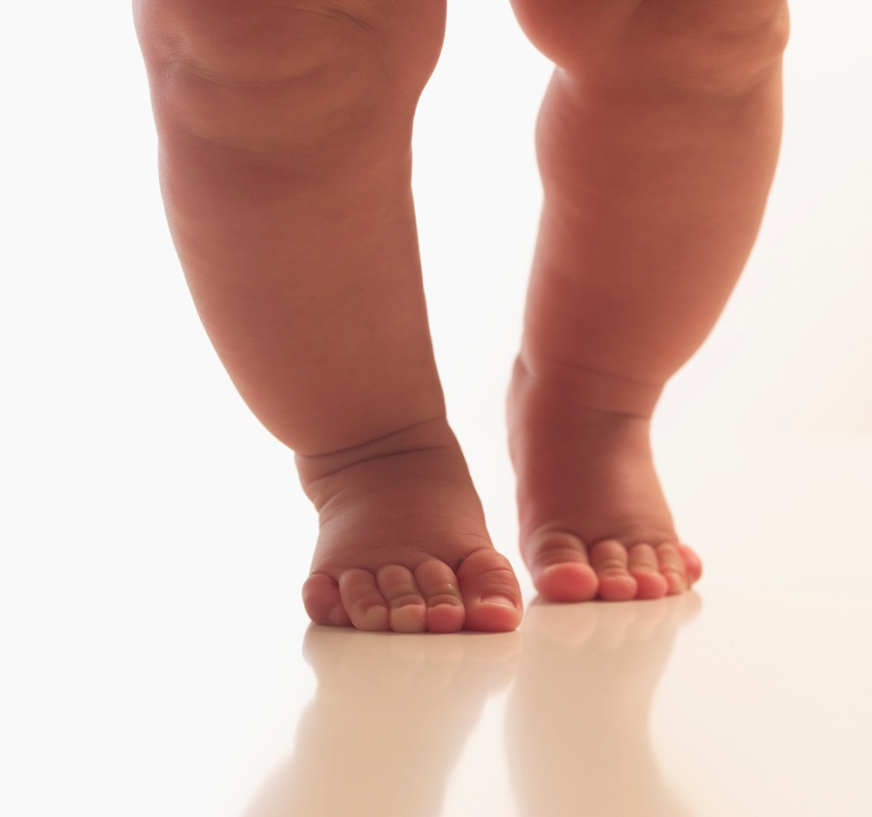
A Strategy to Build Long-Term Interdependence:
Offering Independence
One Step at a Time

Slide 25
Consider Temperament and Developmental Needs
Listen and Invite Youth to Develop a Plan
Generate a Roadmap of Mastery
Independence is Earned through Displaying Responsibility

Slide 26
Stress and Coping

Slide 27
Resilience
Is about learning to cope, in a positive way with life’s inevitable stressors
We might do our greatest good by raising youth with a wide repertoire of positive coping strategies

Slide 28
Relief
Positive Coping Strategies
Stress
Discomfort
Negative Coping Strategies

Slide 29
Distinguishing Paper tigers from Real tigers
Knowing when bad things are temporary
Knowing when good things are permanent

Slide 30
Coping
Engagement vs. Disengagement
Emotion Focused vs. Problem Focused

Slide 31
A Stress Management Plan for Teens
(It Might Just Work For You)
Shhhhh … It is a Great Way to Build a College Resume

Slide 32
Stress Management: Tackling the Problem
1. Making the problem manageable
2. Active Avoidance
3. Let some things go

Slide 33
Serenity Prayer
Grant me the serenity to accept the things I cannot change; courage to change the things I can; and wisdom to know the difference.

Slide 34
Stress Management: Taking Care of my Body
4. Exercise
Fear
Anger

Slide 35
Stress Management: Taking Care of my Body
5. Relaxation
6. Nutrition

Slide 36
Stress Management: Taking Care of my Body
7. Sleep
Shower
Exercise
Cool Down
Stimulation
Release Emotions

Slide 37
Stress Management: Managing Emotions
8. Instant Vacations
9. Releasing Emotions

Slide 38
The worst thing is not to be stressed … it is to be NUMB

Slide 39
Stress Management: Making the World Better
10. Contributing to the world

Slide 40
When Resilience Reaches Its Limits
Physical symptoms
Fatigue
Disinterest
Dropping grades
Sad mood
Irritability/anger
Substance use

Slide 41
When Your Tolerance Reaches Its Limits
Falling Back in Love
Holding to the Highest Expectation
Honoring Your Spouse/Partner
Catching Your Kid Being Good
Focusing on high yield interactions

Slide 42
The Greatest Gift You Can Give Your Child

Slide 43
Fosteringresilience.com

